Slide 1
Criminal activity detection
Break The Shackles 3.0 IEEE BPIT
By Maverics
Team member(Samridhi Bhandari)

Slide 2
Problem Statement
1. Detection of criminal activity like theft, gun firing, bank robbery ,etc.
2.Real time date and time provided to the respected officer about the incident.
3. Raising an alarm system and sending an email to the official using IOT .
4.Recorded video in mp4 can be checked/detected and not just amp file.
5.Detection of criminal activity in crowded area using drone system.

Slide 3
Technology Stack Used
Machine Learning, Python

Slide 4
Our Solution
Using this project code the user will be able to detect an criminal activity such as gun detection in the given video in mp4 format and not just amp format. The idea is to enhance the project to give the exact time and date when incident took place. Also setting up an alarm and sending the mail to officer using api . Drone system will be able to detect the crowd wholly with all angles and ranges also in dim lights.

Slide 5
Police department/cbi
Benefit of this gun detection system will be that the officer would be able to get the exact time and date of that incident.
By adding face recognition to this code, they would be able to recognize the criminal face from the records and hence help them.
The alarm system would alert the officer to get notified about the incident taking place .

Slide 6
General Public
General Public could themselves check the video recordings of their household CCTV footage .
People with poor vision would be able to easily and clearly view the incident taking place.
The user interface used here will allow even children to detect the crime taking place.

Slide 7
Functions
OpenCV based project with application of Machine learning
Coding done in python
Easily runs on IDLE 3.6
cv2 library used for video data
mp4 recordings could also be detected
User friendly

Slide 8
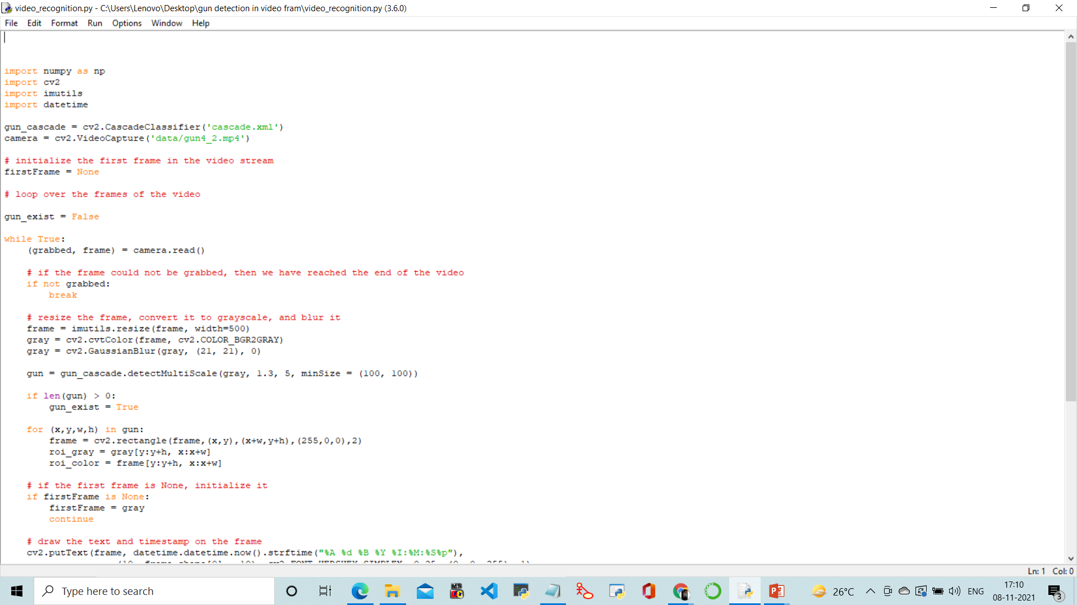
Snapshot of code

Slide 9
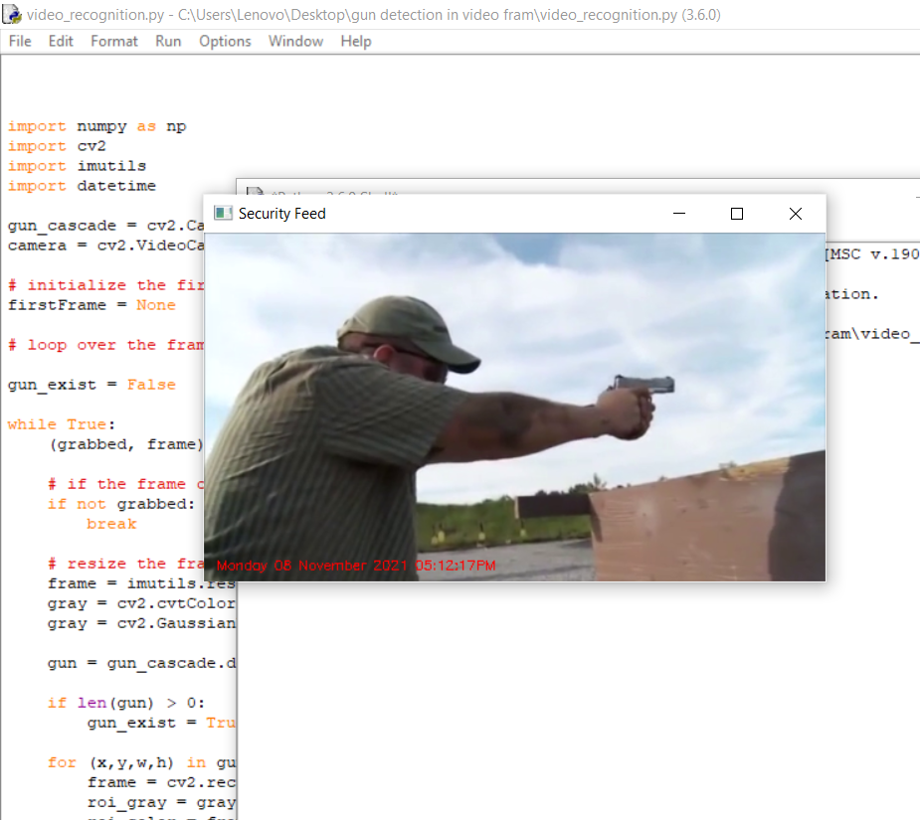
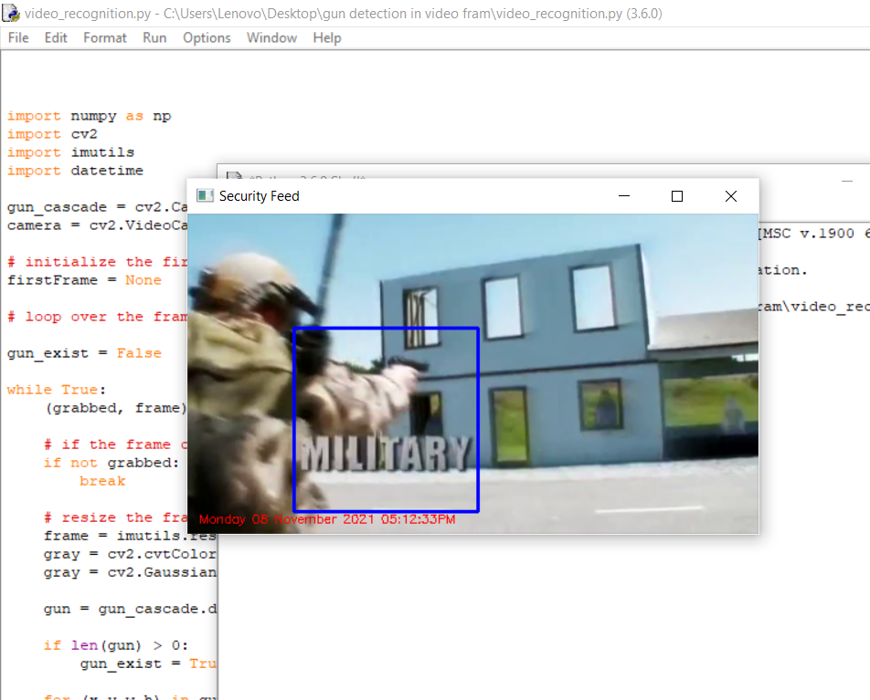
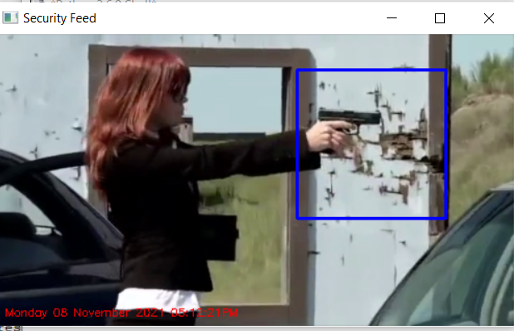
Output sample

Slide 10
THANK YOU
Samridhi Bhandari
HMR Institute of Technology and Management
Project lead
9868503200

